Slide 1
.NET Aspire
The new way to be
Cloud Native in .NET

Slide 2











https://www.isaaclevin.com
@isaacrlevin
https://www.coffeeandopensource.com
@isaacrlevin
@isaacrlevin@fosstodon.org
@isaaclevin.com

Slide 3
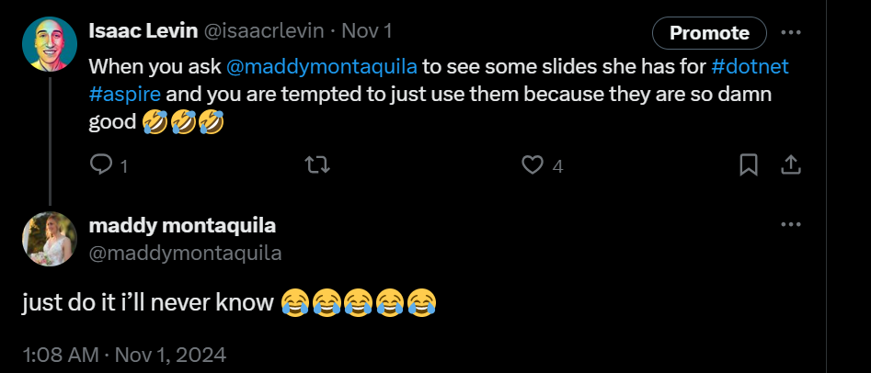

Slide 4
What do you need to build a solution?

Slide 5
What do you care about when building an app?
What kind of app is it?
Front-end/Backend/Both?
What dependencies does it have?
Database? Telemetry? External APIs?
How is it going to run in Production?

Slide 6
Every App Needs
Observability
Resiliency
Scalability
Manageability
Notes:
No matter what type of application you're building every single application needs to be observable to get deep insights while you're debugging your application and while it's out into production. Additionally, they need to be resilient which means that no matter what the Internet connectivity is or the environment they need to be always up and running not only on the front end but also on the back end. They have to be scalable your application today much of serve a few 100 people but what happens when it serves 10s of thousands or hundreds of thousands of users. And finally, as a developer we want to be able to easily manage our application and easily deploy them so we can continuously and rapidly iterate on our apps.

Slide 7
But most solutions can get complex

Slide 8














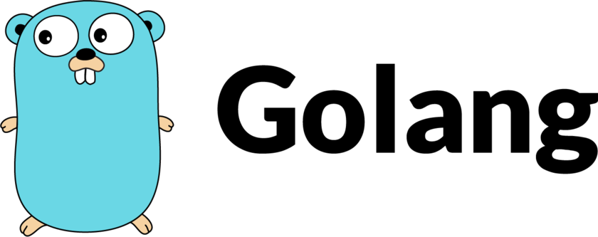
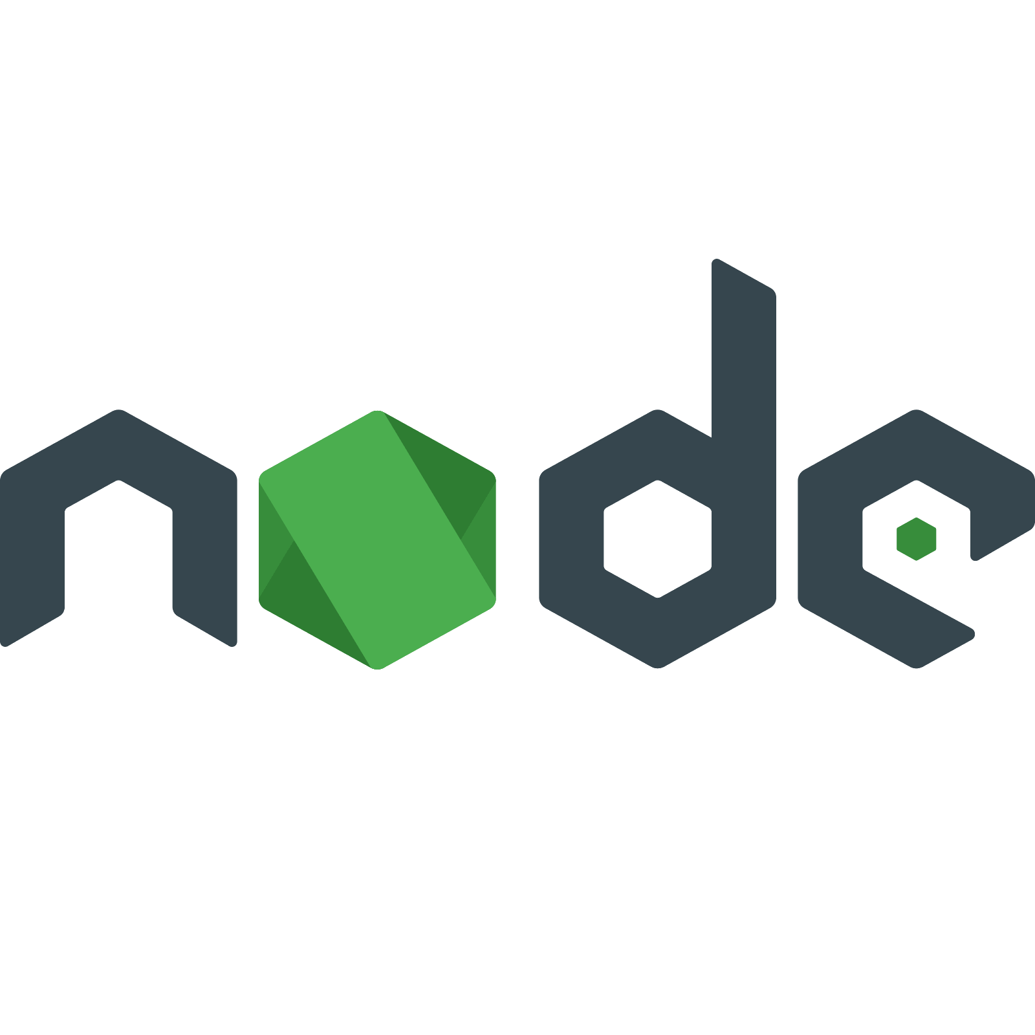


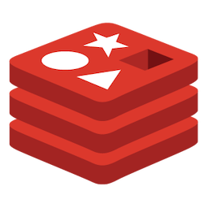
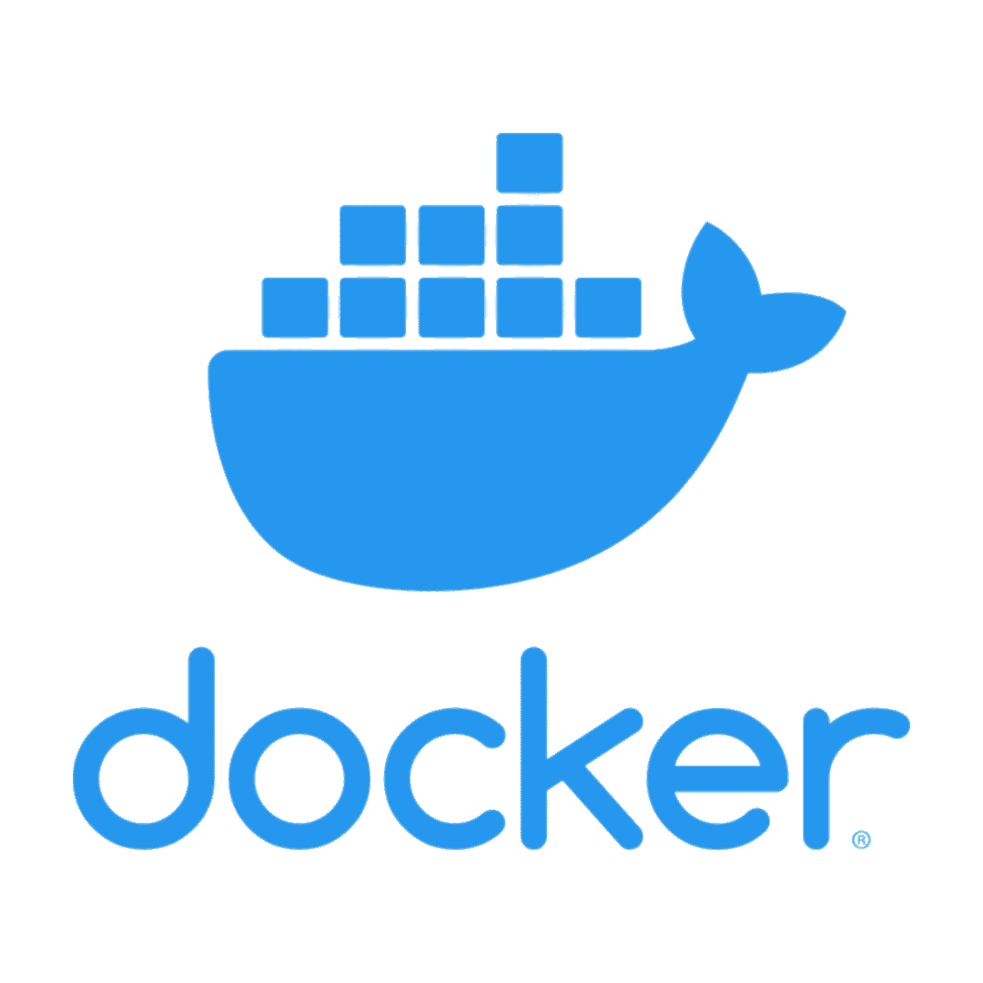






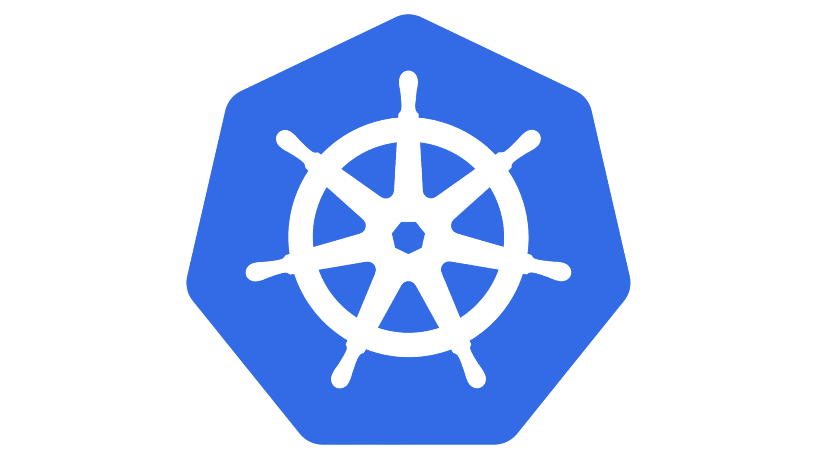
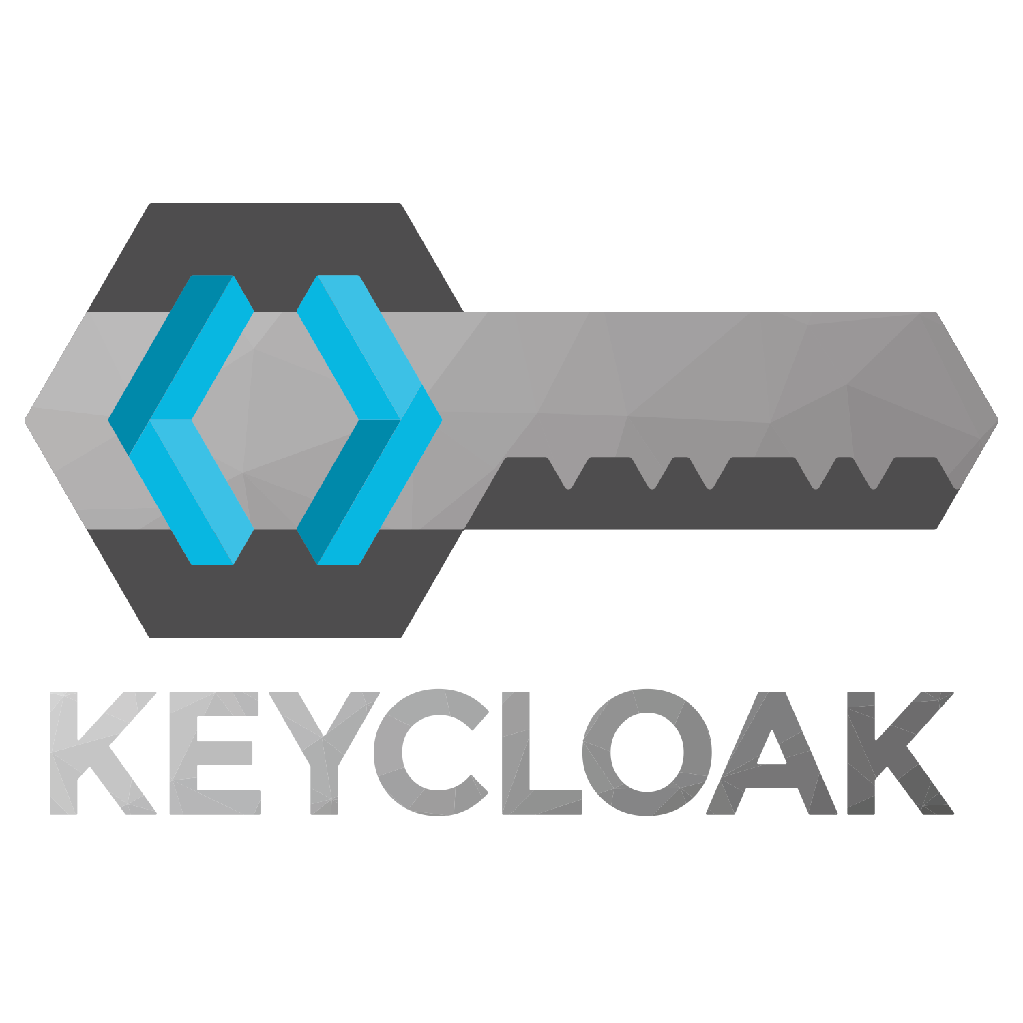


Your average developer deals with:
Caching
Databases
Local development tools
Messaging + queueing
Containers?!
Multiple languages
A zillion deployment targets
Resiliency + scalability
Security + networking
CI/CD
Storage but… not databases?!
Telemetry and logs and traces
Authentication
AI?!?!?!
and so much more!

Slide 9
And then there’s getting started…
Acquire all the dev tools
IDE/editor
Language SDKs + runtimes
Container system + emulators
Get all the pieces working individually
Or… deploy to a staging environment
Don’t forget to authenticate! Somehow!
Ever heard of mock data? You have now!
Don’t forget the one random specific thing your company requires!
Connect them all? Maybe?
Or just test them individually and hope it works in prod
If you’re lucky someone wrote a script
Write code…
…and hope you’re setting the right things
Learn quirks of the individual services
Do not touch anything or it all breaks instantly

Slide 10
So how can we be more productive?

Slide 11
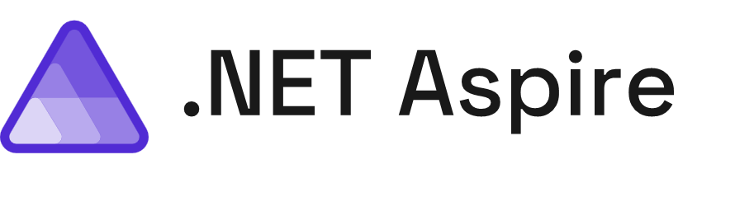
Powerful tools, templates, and packages for building observable, production-ready apps
Streamlined Inner-Loop
Developer Dashboard
Integrations
Deployment
OpenTelemetry built-in, YAML-free, multi-cloud, and extensible
Notes:
.NET Aspire is a collection of flexible tools, opinionated templates, and curated packages for modern developers. Aspire simplifies managing projects, resources, containers, microservices, and more – at development time while you write code.
Plus, Aspire gives you real-time insights into your app while you’re actively developing it – no more pushing to staging environments or production to see how your changes play with the rest of your stack.
We’ve worked with a bunch of popular cloud library and service authors to create integrations that simplify setting up and managing all of the various resources you need to build production apps at scale, and to help you build secure-by-default apps in a world where cyberattacks just don’t stop.
We’ve also worked with teams in Azure and AWS to simplify basic deployments to get your apps up and running, and your fixes shipped to your customers, faster than ever.
I’ve had the privilege of working on Aspire the past few months with a ton of amazing engineers and architects, including Damian – what’s up d00d

Slide 12

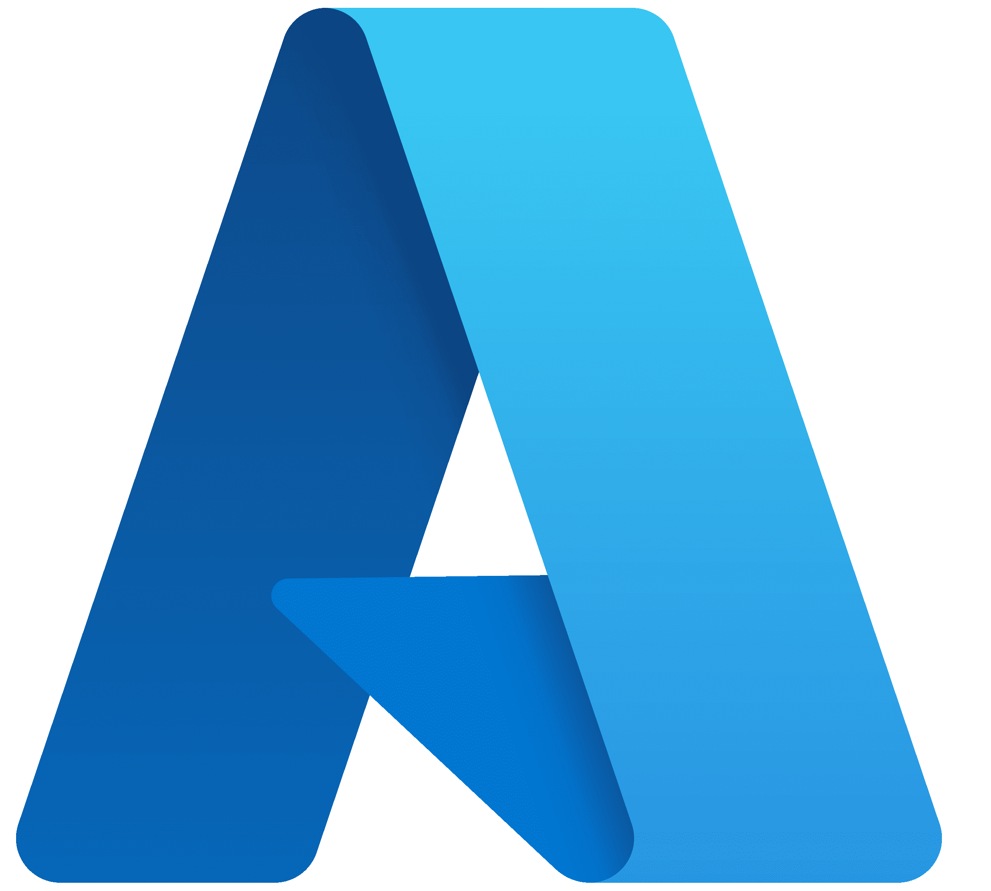

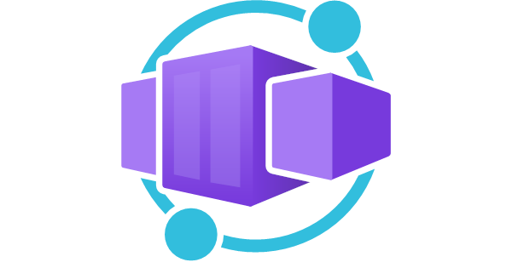
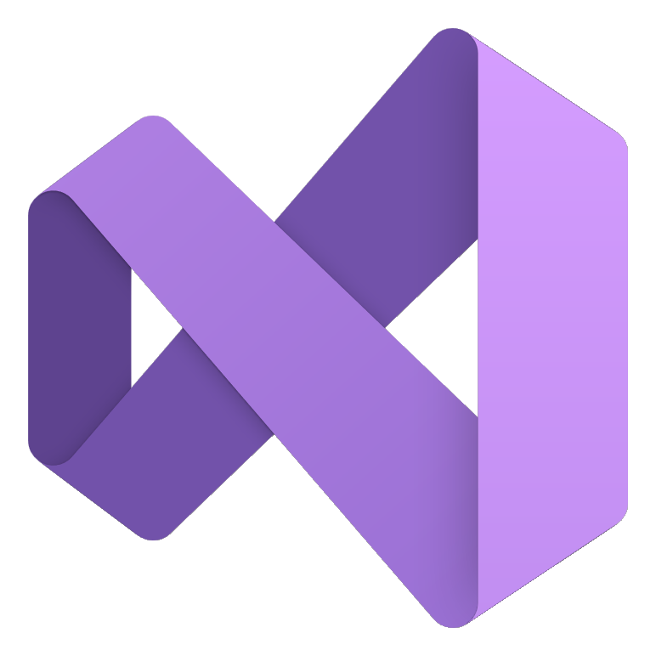



Azure Functions preview support
More secure defaults
“WaitFor” resources to spin up
Start/Stop Resources
Improved
Azure Configuration
Simplified acquisition
.NET Aspire 9.0
Improved Azure Container Apps integration
Persistent
Containers
Visual Studio & C# Dev Kit enhancements
.NET Aspire Community Toolkit
Support for
.NET 8 & .NET 9
OpenAI Integration
AWS Stable Integrations
Announced at .NET Conf
Notes:
.NET Aspire 9.0 will GA Nov 12 and is compatible with both .NET 8 and .NET 9 applications. We can’t wait for you to explore every part of .NET Aspire in your developer process and we hope you join us to go deeper on what’s new in .NET Aspire with David Fowler tomorrow.

Slide 13
Aspire Getting Started
Demo

Slide 14
What makes aspire worth it?

Slide 15
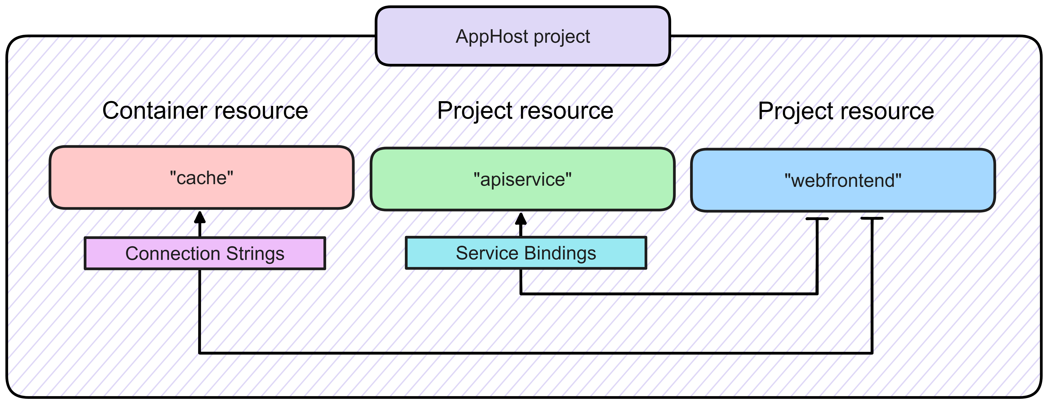
orchestration

Slide 16
Doing the wiring for you
Service Discovery
Service Defaults
Health checks
Telemetry

Slide 17
.net aspire integrations
External resource
Environment Variables
Hosting Integrations
Node or Python apps
Resource configuration
Container Runtime
Aspire Service Discovery
Aspire Service Discovery
Container Resource
Your Project Code
Your Project Code
Client Integration
Client Integration

Slide 18
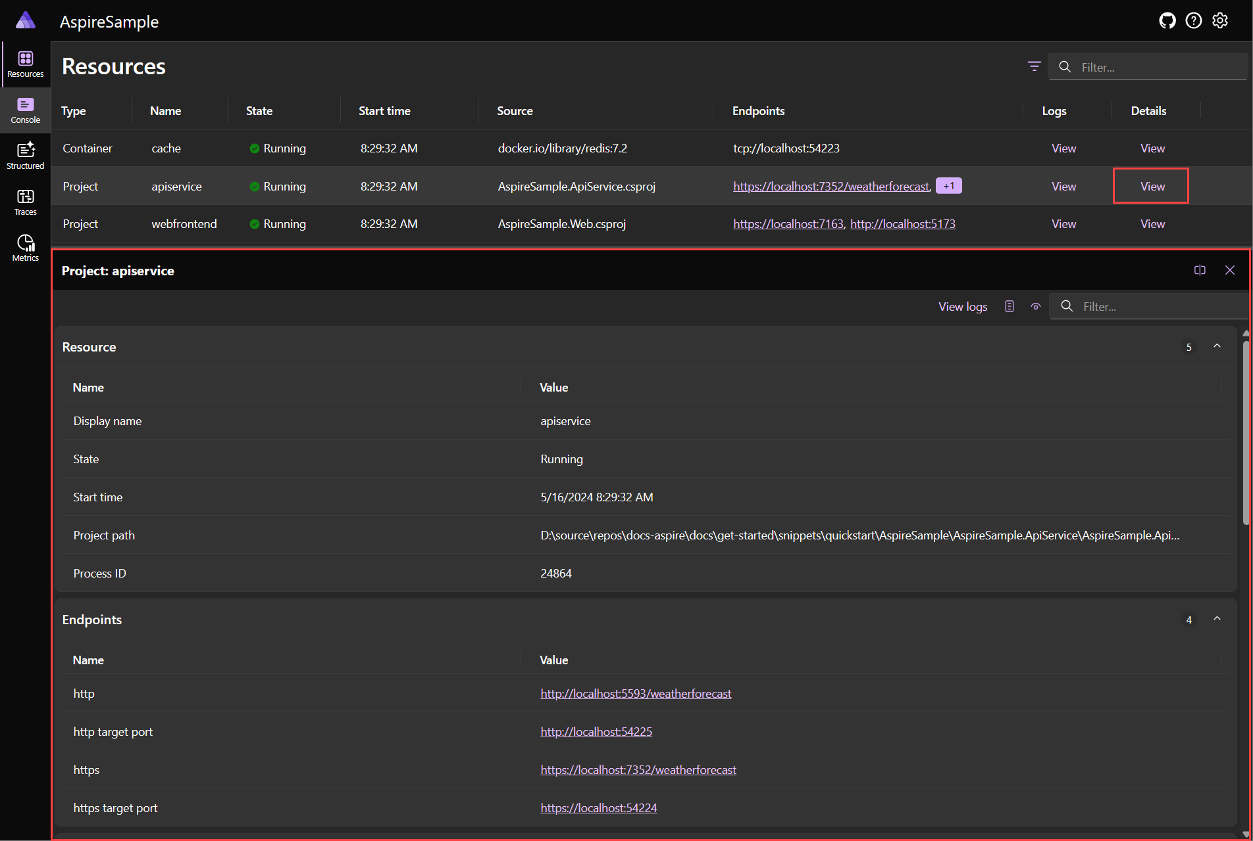
dashboard

Slide 19
ADDING ASPIRE TO YOUR SOLUTION
Demo

Slide 20
But what happens when I need to Deploy?

Slide 21
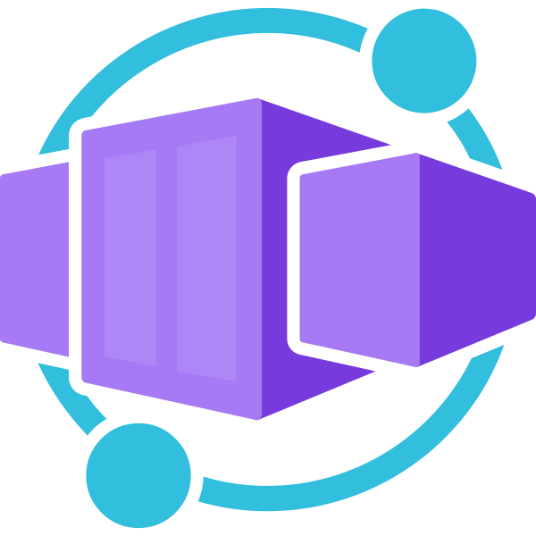

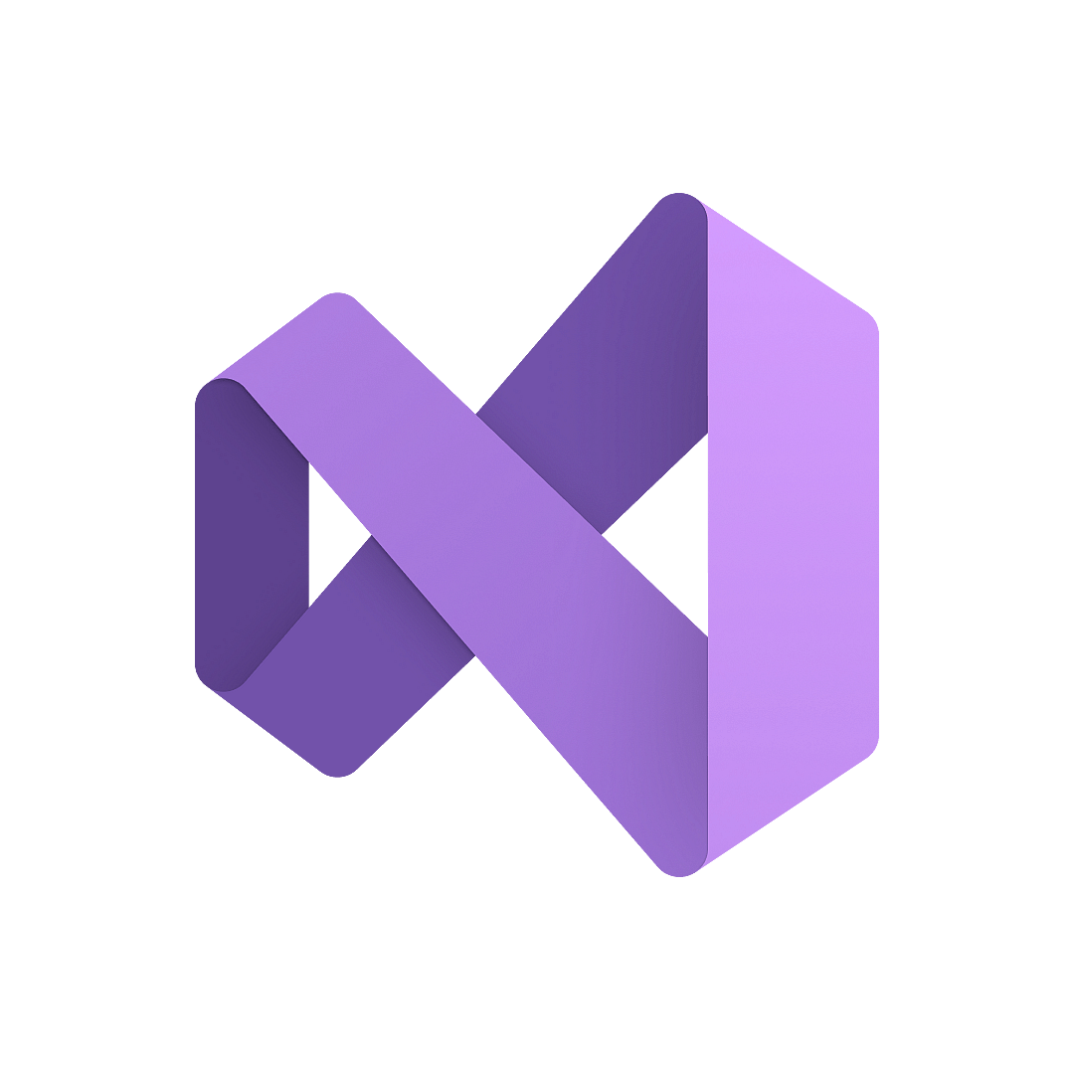





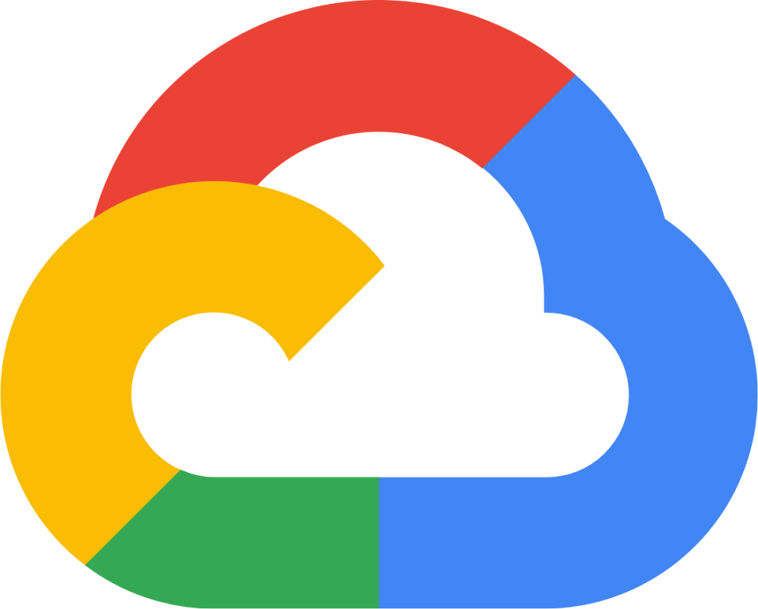

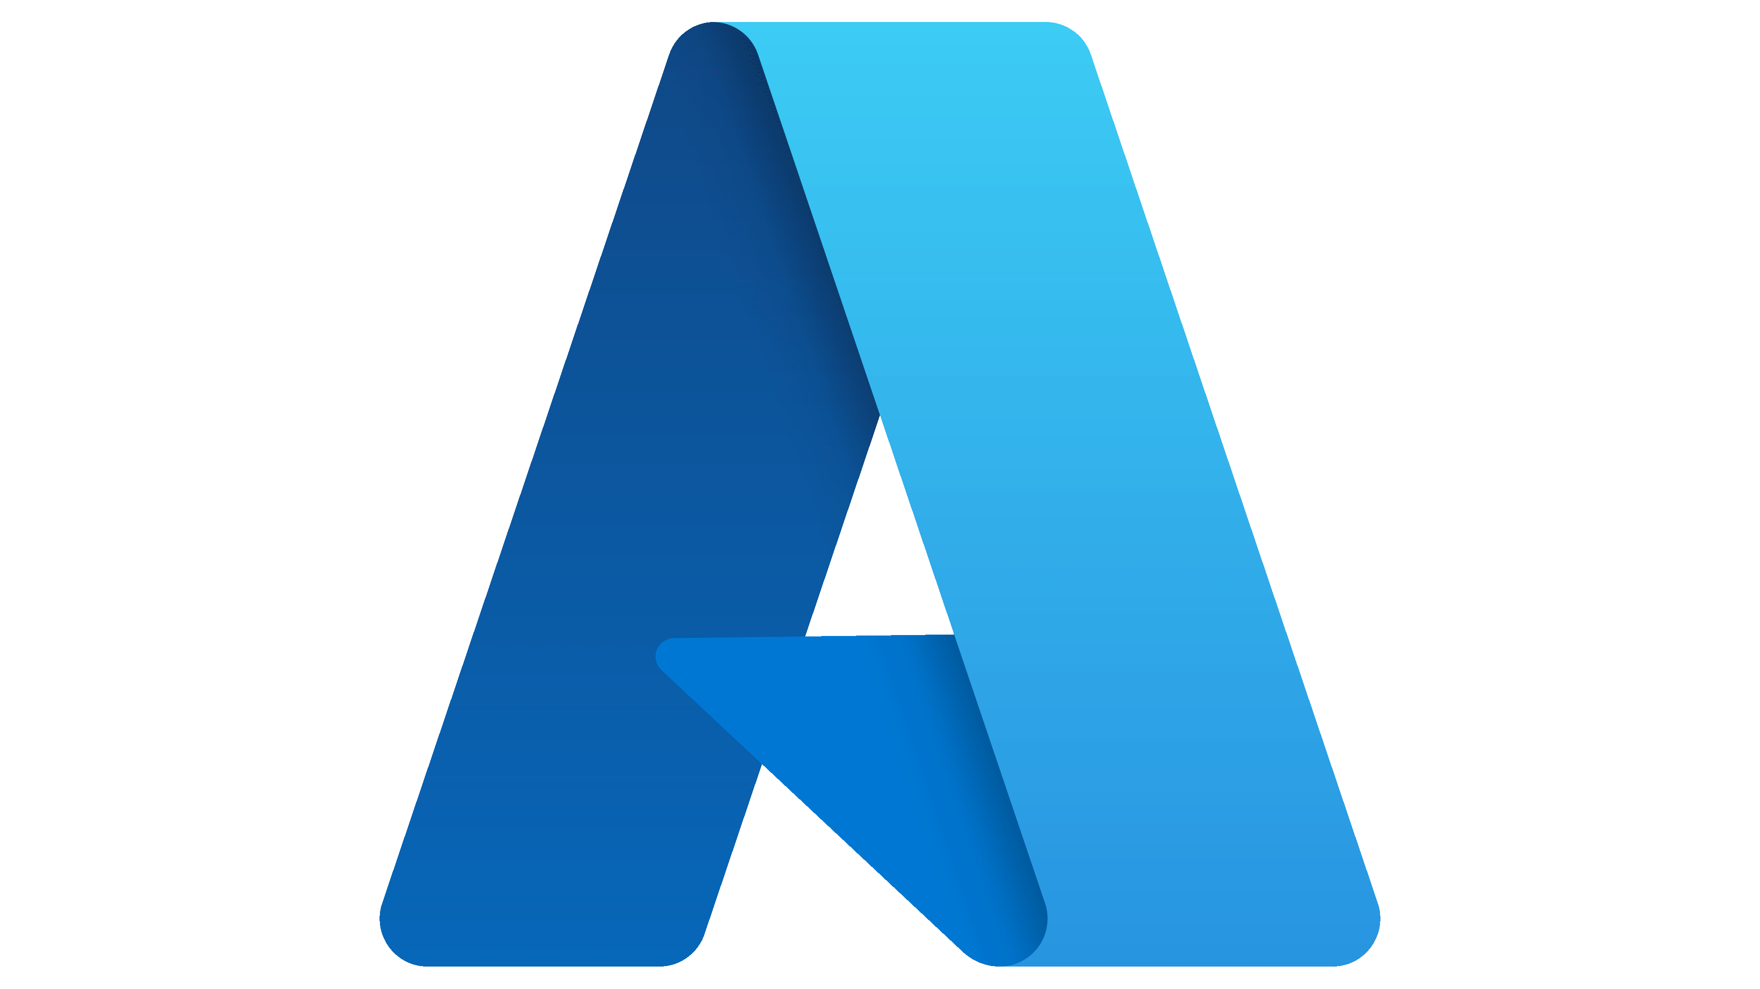

Flexible Deployment with .NET Aspire
How You Do It Today!
AWS CDK
Azure Dev CLI
Visual Studio

Slide 22








Run your containers your way
Simplicity
Control
Azure Container Apps
Azure Kubernetes Service
Serverless application platform for building containerized microservices
Managed clusters with full access to the Kubernetes API
Microservices APIs
Event-driven autoscale
Any developer • Any language • Any platform

Slide 23
Run your containers your way
Simplicity
Control
Azure Container Apps
Azure Kubernetes Service
Time to market
Scale to zero
Embedded app patterns
More dev, less ops
Industry standard
OSS ecosystem access
Customization
Rich access policies

Slide 24
Aspire to the cloud
Demo

Slide 25
What else can aspire do?

Slide 26



.NET Aspire Community Toolkit
github.com/CommunityToolkit/aspire

Slide 27



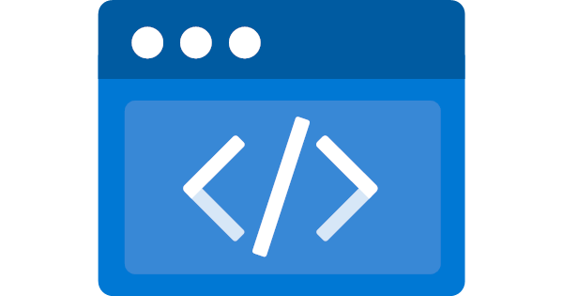

Community built integrations

Slide 28
Aspire Going above and beyond
Demo

Slide 29


Thank you
https://isaacl.dev/aspire-talk

